Slide 1
Milestones
Notes:
Knowledge regarding the Milestones in the GME community is variable. This presentation will provide a general overview of the Milestones.
This slide deck was created in December 2013 and care should be taken to ensure that updates and changes that have occurred since then are incorporated to provide an up to date and accurate presentation.

Slide 2
Implementing Milestones
Objectives:
Define the Milestones
Explain how the Milestones work
Describe how to assess for the Milestones
Notes:
Three key points will be addressed in this presentation.

Slide 3
Six Core Competencies
Medical Knowledge
Patient Care
Professionalism
Interpersonal and Communication Skills
Practice-based Learning and Improvement
Systems-based Practice: system improvement
Transition from process to outcomes
Notes:
The Core Competencies were developed 10 years ago, and should be familiar to everyone by now. They were introduced as a way to better define what physicians should know and be able to do.

Slide 4
The Outcome Project
1999 - Outcome Project Begins
2001- Quadrads (Board, PD, RRC, Res) Convened
2002-2008 – Implementation of 6 Competency Domains
General Competencies Defined
Translate core competencies into specialty-specific competencies
Residency programs expected to develop instructional and assessment methods for integrating the competencies in their curricula
ACGME assessment “toolbox” developed
Increasing emphasis on educational outcomes (vs. process)
Portfolios were the next big hope
Notes:
The Core Competencies were part of the movement to better measure outcomes. The desired outcome is to ensure that programs educate physicians who can practice independently. Programs had difficulty defining or measuring the outcomes, and assessment tools were never fully developed to help programs to measure the outcomes. Milestones were created with the goal to allow programs to more accurately evaluate the outcomes of residency education.

Slide 5
Milestone Project Goals
The Outcome Project had difficulty in measuring outcomes: resident performance and competency
Milestones provide a more explicit definition of expected resident knowledge, skills, attributes, and performance
  Expand outcome evidence for accreditation and certification
  Enhance public accountability
Notes:
The Milestones were developed to address those shortcomings, by making assessment more explicit, more concrete, and easier to understand and measure.

Slide 6
Expected Benefits of Milestone Assessments
Benefits for Residents
Explicit expectations of residents
Identifies areas to work on
Improve evaluation of residents in all six general competencies
More defined feedback from faculty members to residents
Earlier identification of under-performers
Provides aspirational goals for residents exceeding expectations
Notes:
In early experience with Milestone assessment, some observations have been that residents appreciate the more detailed and specific evaluations that milestones allow, compared to previous evaluations merely stating they had done a “good job.” Milestone evaluations provide a process to set expectations on what more there is to learn or what a resident has to accomplish to move to the next level. One of the goals in looking at each resident more closely is to identify residents who have gotten by because they are nice and easy to work with, but who actually had significant deficiencies in different skills and areas in the subcompetencies. The focus on specific skills and knowledge in the Milestones help to identify these residents and determine which in competency or subcompetency areas in which they need to improve.

Slide 7
Expected Benefits of Milestone Assessment
Benefits for the Program
Guide curriculum development
Guide accreditation requirement revision
Earlier identification of under-performers
Benefits for the Public
Better definition of what a physician can do at the completion of training
Use for program accreditation
Possible use for board certification
Notes:
Some program directors have also suggested other benefits. In looking at the Milestones, a program may discover that the current curriculum may not be teaching a competency to the expectations set for Level 4. The benefits to the public may be less clear to individual programs, but allow policy makers to understand some of the specific skills that future physicians in practice are learning. Currently the ACGME only expects each program to collect and use the Milestones in assessing their residents. The ACGME does not expect that every resident meets a specific level at a particular point in residency. The goal is to use Milestone assessment to thoughtfully and honestly evaluate each resident. The Review Committee will not look at an individual resident’s Milestone attainment. Each specialty board will determine on its own whether and how to use Milestone data in board certification.

Slide 8
What are Milestones?
General Definition: Skill and knowledge-based development that commonly occur by a specific time
Milestone definition (ACGME and Specialty Boards): Specific behaviors, attributes, or outcomes in the six general competency domains to be demonstrated by residents during residency
Notes:
The concept is to use descriptors of specific behaviors to describe how a resident is progressing in learning the skills and knowledge defined by the Core Competencies.

Slide 9
General Competency
Developmental Progression or Set of Milestones
Subcompetency
PC1. History (Appropriate for age and impairment)
Level 1 | Level 2 | Level 3 | Level 4 | Level 5
Acquires a general medical history | Acquires a basic physiatric history including medical, functional, and psychosocial elements | Acquires a comprehensive physiatric history integrating medical, functional, and psychosocial elements Seeks and obtains data from secondary sources when needed | Efficiently acquires and presents a relevant history in a prioritized and hypothesis driven fashion across a wide spectrum of ages and impairments Elicits subtleties and information that may not be readily volunteered by the patient | Gathers and synthesizes information in a highly efficient manner Rapidly focuses on presenting problem, and elicits key information in a prioritized fashion Models the gathering of subtle and difficult information from the patient
Milestone
Notes:
It will help to agree on some terminology. The “General Competency” refers to one of the six Core Competencies. In this example, “PC” is for “Patient Care”, one of six Core Competencies. “PC1. History (Appropriate for age and impairment)” is a subcompetency under the first of several subsections of “Patient Care”. A Milestone is actually the description of how a resident is doing and the entire set of milestones for one subcompetency can be called a Set of Milestones. Notice that the Milestone narratives do not indicate level of education or the years in the program but by levels merely to signify that the next Milestone is more advanced than the level below it. Residents are expected to progress at different rates.

Slide 10
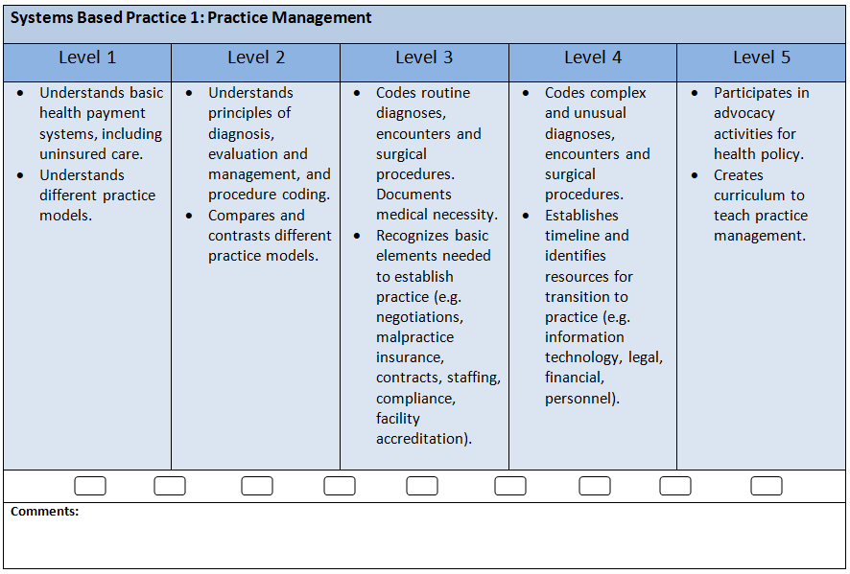
Sample Milestone
SBP 1: Functions in the current reimbursement system
Notes:
This is an example of how a Set of Milestones would look like for a subcompetency of reimbursement in the general competency of Systems-based Practice (SBP). Note that the language is in general terms and requires faculty members to discuss and agree on a “routine diagnosis, encounters and surgical procedure” and how that differs from a “complex and unusual diagnosis, encounters and…” That is the primary difference between a Level 3 and Level 4 milestone. There is still some interpretation necessary by an individual program's faculty for certain milestones. A Set of Milestones, then, provides a guide or road map for programs to use and teach the skills noted in each of the milestones within it.

Slide 11
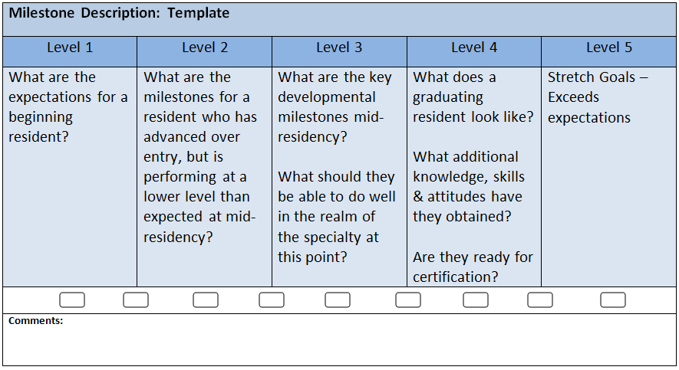
Milestone Template
Competency and Sub-competency described
Notes:
This is what the five levels look like in the tabular form that will be used for Milestone reporting. Note that the form offers check-off boxes between Levels, recognizing that a resident might be best described at Level 2.5, for example, if he or she has met most of the Level 2 and some but not all of the Level 3 milestones. Level 5 milestones are aspirational goals that only a few exceptional residents will reach, but that not every resident would be expected to attain. Level 4 describes the graduation target, but every resident does not need to reach Level 4 in every competency or subcompetency in order to graduate. It is still the purview of the program director to determine if and when a resident is ready for independent practice.

Slide 12
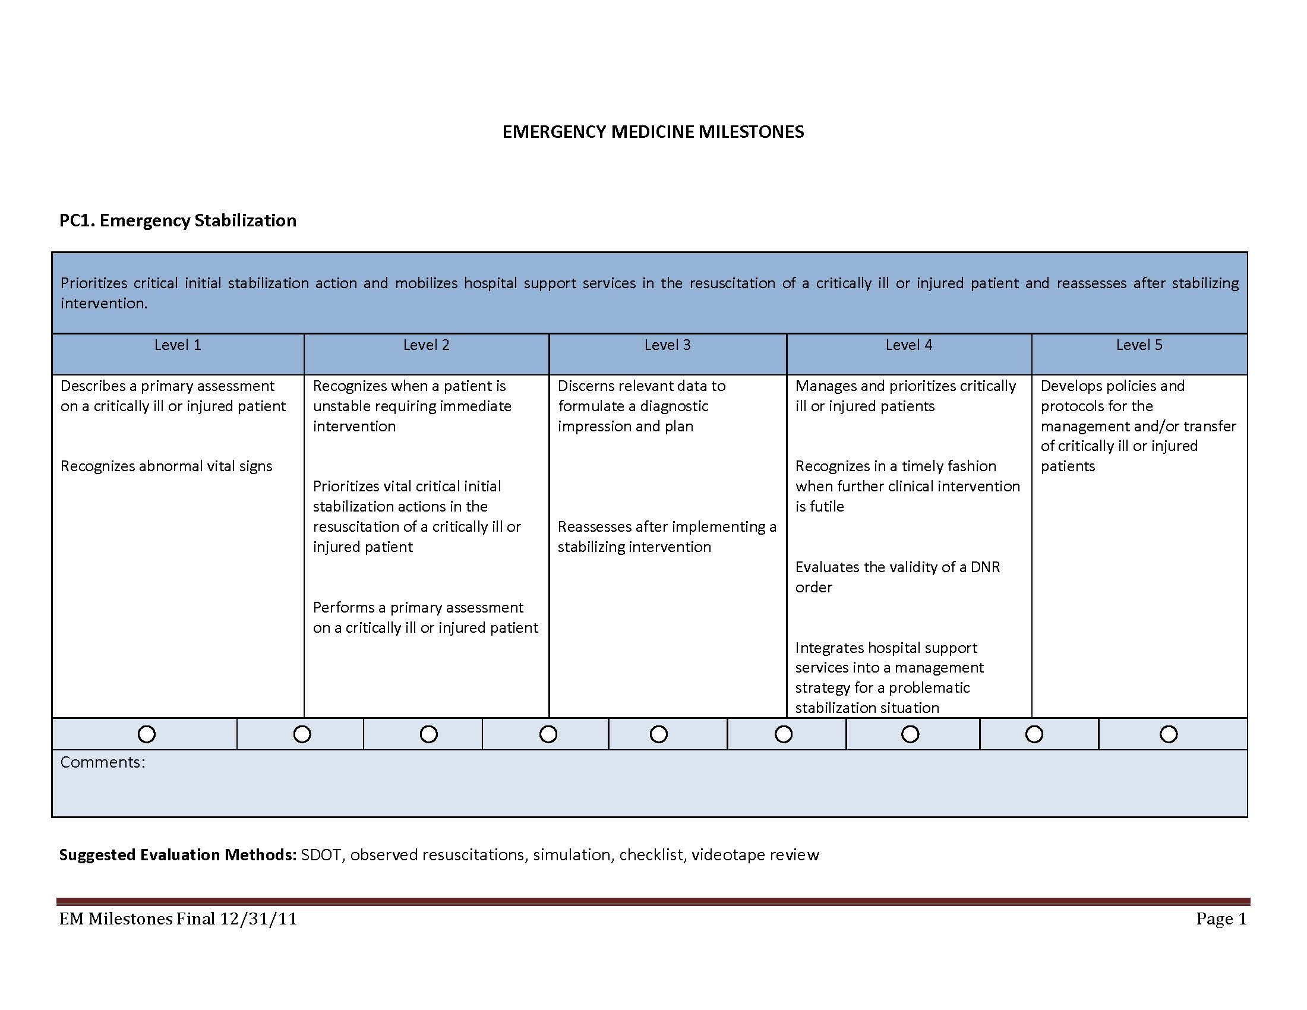
Notes:
This is an example of a Set of Milestones for the Patient Care (PC1) subcompetency of Emergency Stabilization in the Emergency Medicine Milestones. Note that across the levels, the verbiage of the first milestone (the first item in each column) identifies the progression of how a resident is expected to perform as he or she learns: The Level 1 expectation is for the resident to provide a description of a critically-ill or injured patient; at Level 2, more responsibility is expected; the Level 3 description includes a higher level of thinking to identify important information and using that information to develop a plan; at Level 4, the expectation is for a resident to recognize, evaluate, and manage a critically-ill patient, and integrates hospital support services to their management strategies.
Note that each level has more than one description. In general, to agree that a resident has met Level 3 milestones, it means the resident has met all of the Level 2 milestones and meets most or all of the Level 3 milestones. It might be very possible for a resident to have met milestones at different levels, perhaps some at Level 2 or Level 3 or even some at Level 4. The idea is that marking a level means that a resident has substantially met the milestones at that level.

Slide 13
Diagnostic Radiology:
Interpersonal and Communication Skills
Communication with other physicians: formal reporting | PGY 1 Describes the important components of written communications between physicians and is aware of the contribution of poor written communication to medical error. | PGY 2-3 Is proficient in speech recognition and self-editing and adheres to institutional/ national policies for reporting in radiology. Radiology reports accurately describe findings in simple and emergent cases. Impression is clear and concise. Reports accurately identify urgent and unexpected findings. Few corrections required by attending radiologist | PGY 3-4 Accurately and efficiently dictates reports even in complex cases and demonstrates a turnaround time in-line with peers; reports for complex cases accurately convey findings and impression as discussed with attending radiologist. | Grad resident Produces a concise report with significant findings, impressions and recommendations and can accurately identify all urgent and essentially all unexpected findings in the report. | Prac Grad Is a role model for written reporting and actively teaches junior level residents and provides feedback.
Notes:
Some of these Milestones will need discussion by the faculty to agree on the meaning of “proficient”, “simple”, “few corrections”, “complex”, “accurately”, “concise”, and so on. The advantages of using general terms is that it allows the Milestones to be applicable in several clinical settings and various patient care scenarios. In this case, the Milestones have been “lumped” into a single description with several parts to each individual Milestone. Each specialty has different approaches to the same task.

Slide 14
How Do we Assess Milestone Levels?
Milestones are not assessment tools to be used for gathering detailed information
They do not replace end-of-rotation forms, simulation, multi-source evaluations, Objective Structured Clinical Examinations (OSCEs), which are completed by individuals
More pieces of data allow for more precision
Notes:
Each Set of Milestones is not meant to be used as an end-of-rotation form for a rotation. Each program will still need “data collection tools” which will ask specific questions. For instance, the information that we gather from a multi-source evaluation from a nurse or a technician may focus on teamwork skills, professionalism, and communication, but not ask about medical knowledge. An end-of-rotation form may differ for a clinic and an inpatient rotation, or for gathered through the use of these different data collection tools will be summarized by Milestone assessment.

Slide 15
Examples of Assessment Tools
  Global ratings scales
    Likert scales reveal bias toward high scores
    Should be anchored
  Objective structured clinical examinations (OSCE)
  Simulation assessments
  Check-off sheets
  Mapping of current evaluation tools/questions to sub-competency milestones
  Extrapolation of results of:
    Team building exercises
    Merit badge courses- ACLS, ATLS, PALS
    Specific rotations
Notes:
Current assessment tools can be used to evaluate residents, and the results of those evaluations would be used by the Clinical Competency Committee (CCC) to determine the Milestone attainment of each individual resident. Some examples of assessment tools used by some programs are listed. If global rating scales are used, note that responses to Likert scales are often weighted toward high scores.

Slide 16
How do we Assess Milestones Levels?
Milestones are a summary of how a resident is progressing
We have to gather data to be able to decide on how residents progress on the milestones
Some subcompetencies may be more amenable to monthly, quarterly, or semi-annual global rating scales, some may be collected once during the entire program
Notes:
The Milestones will ultimately be a summary of the information gathered by several evaluations. Some subcompetencies may not be measured on every rotation or every experience. For example, if residents must complete one quality improvement project or one scholarly activity during residency, there may be just a single assessment during the program for that project.
Some milestones may be difficult to measure with existing assessment tools or forms, and new methods may have to be developed. For example, a resident might need to serve on a quality committee with an assessment by the committee chair to address certain questions. An individual program may not have collected this information before, so a new assessment tool to address the milestones for this activity might be necessary.

Slide 17
Assessment Issues
Can the Milestones Report replace current assessment tools or end-of-rotation evaluation forms?
  Pros: when it is relevant and fits the situation; when it is understood by the evaluator
  Cons: when Milestones language is too broad or general or does not apply to the experience; too many milestones to assess
Notes:
While it may make sense to ask about Milestone attainment and use the Milestone language for some rotations/experiences, Milestone language is often broad and general, and may be an insufficient descriptor of the specific skills and knowledge to be learned in one specific rotation/experience. It may be better to ask more specific questions that apply directly to the rotation via a rotation-specific tool or form. Not every competency or subcompetency will be covered on every rotation, and so using the Milestones Report may not be applicable, as each Set of Milestones addresses progress over time.

Slide 18
The Resident’s Milestone Level is Determined by the Clinical Competency Committee
A group of faculty members looking at the Milestones
The same set of eyes looking at other evaluations:
  End-of-rotation
  Nurses
  Patients and families
  Peers
  Others
The same process is applied uniformly
Allows for more uniformity and less individual bias
Notes:
Having more evaluators should more closely reflect the opinions of members of the teaching faculty and minimize individual biases. One of the advantages of using the Milestones is the development of common understanding among members of the faculty as to the program’s expectations for residents.

Slide 19
Clinical Competency Committee
Mock Orals
Self
Evaluations
Case Logs
End-of-Rotation Evaluations
Operative Performance Rating Scales
Unsolicited
Comments
ITE
Sim
Lab
Student Evaluations
Nursing and Ancillary Personnel Evaluations
Clinical Competency Committee
Clinic Workplace Evaluations
OSCE
Peer Evaluations
Patient/
Family Evaluations
Assessment of Milestones
Notes:
Overall the goal is to have the CCC review input from different sources. Assessment methods might include the evaluations that are currently being used by programs. Not all of the evaluations of one resident will be consistent, so the role of the CCC will be to consider them all and make an overall decision on how the resident is progressing, which milestones have been met, and which to continue to work toward.

Slide 20
Development Schedule
2013 July – seven Phase I specialties begin
using the Milestones
Report in December 2013 and June 2014
2014 July – all Core specialties and most phase I subspecialties start using the Milestones
Report in December 2014 and June 2015
2015 The Milestones for all subspecialties are
developed and in use
Notes:
As the Milestones are developed by each specialty, they will be introduced and used in the following academic year. Milestones for subspecialties are implemented one year following implementation of their related core specialty Milestones.

Slide 21
Summary
What are the Milestones?
How do we assess for the Milestones?
What does the ACGME expect?
Notes:
The goal of the slide presentation is to address these three key points, and it is important to remember that as we gain experience in the use of the Milestones that the community will develop new ideas and continue to improve the way it assesses and evaluates residents.

